Slide 1
Department of Epidemiology and Public Health
Women, WASH and Health in Rural Pune
Identifying Stress and Unmet Needs
Research Partner: Vadu Rural Health Program, KEM Hospital Research Center
Dr. Peter Steinmann
Water and Health Conference 16 October 2014 - Chapel Hill, NC, USA

Slide 2
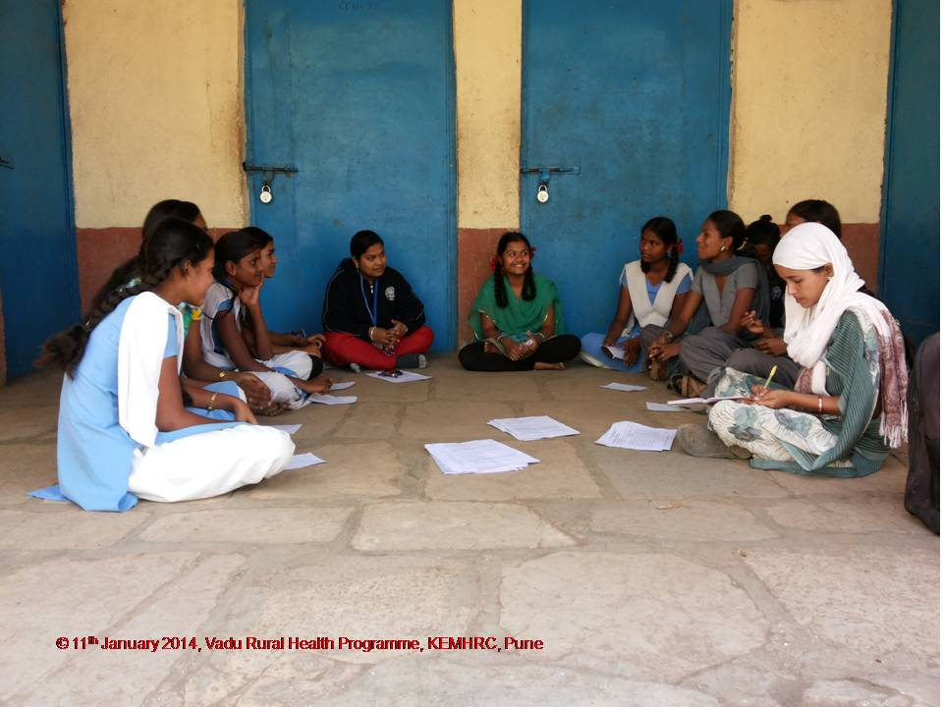
Overview
Background and rationale
Setting and methods
Findings
Implications

Slide 3
Study
Women, WASH and Health in Rural Pune District. Identifying stress and unmet needs
Collaboration between Swiss Tropical and Public Health Institute and KEM Hospital Research Centre/Vadu HDSS
Two site-PIs: Dr. Sanjay Juvekar; Dr. Peter Steinmann
Funding: Open call for proposals, funding from UK Department for International Development (DFID) though the SHARE Research Consortium and the Water Supply & Sanitation Collaborative Council (WSSCC)
Duration: 2013-2014
Location: Vadu (near Pune, Maharashtra, India)
Status: Data collection and analysis completed, publication ongoing

Slide 4
Background and rationale
Limited evidence!
Access
Toilets
Latrine (improved, unimproved)
Open defecation
Psychosocial stress
Cleanliness
Personal insecurity
Infectious disease
Environmental safety
Indignity - shame
Public
Workplace
School
Home
Coercion - punishment
Problems of use
Facilities and setting
Health impact

Slide 5
Conceptual framework of research plan
Basic needs
Defecation-urination
Nutrition-hydration
Facilities, resources
Toilets, sewage and fields
Water and food
Other factors
Personal prior experience
Family and community experience and expectations
Menstruation
Absorbent materials (availability and disposal)
Social and cultural values
Practice
WASH-related behaviour - preference, use and maintenance of facilities; hand washing
Coping strategies, including limiting dietary and fluid intake
Menstrual hygiene
Effects
Self-perceived health and social problems or benefits of reported practices
Psychosocial effects, stress, dignity and quality of life (personal, family and community)

Slide 6
Aims of Proposal
Identify sources of psychosocial stress with reference to personal experience, reported accounts and perceived vulnerability to violence that affect access and use of various types of sanitation facilities and open defecation.
Identify women’s preferences, priorities, practices and perceived needs regarding menstrual hygiene, distinguishing preferred and available options, assessing the stress imposed by social expectations and cultural values and clarifying perceived effects on women’s health.
Assess the level of stress, priority and self-perceived effects of limited access to water and sanitary facilities, and the extent to which such concerns may lead to coping strategies that involve limiting intake of food and liquids.
Determine the availability, functionality and perceived adequacy of sanitary infrastructure in local health facilities, with particular attention to those facilities providing prenatal and obstetric care. Clarify whether these concerns influence the preference and use of accessible health facilities.

Slide 7
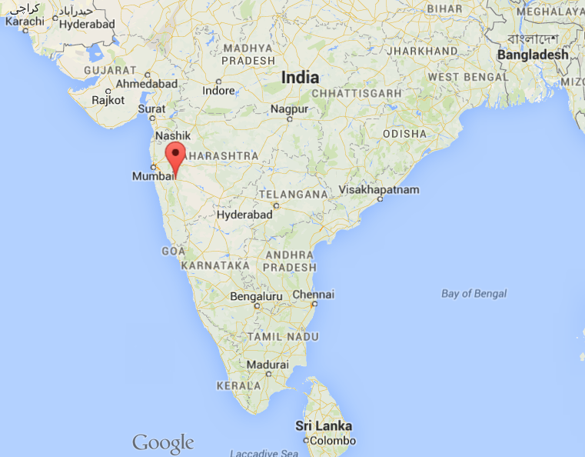
Setting and methods
Pune district: semi-rural area; >100,000 population in 22 villages
Private and public health facilities
Monitored by HDSS since 2002
Farming, industrialization started along highway
In-migration (labour, seasonal)
Limited representativeness for rural India

Slide 8
No. | Research Method | Sample
1. | Quantitative
 | Survey questionnaire | 165 adolescent girls (13-17 years) 143 adult women (18-45 years)
 | Health facility infrastructure assessment | 12 health facilities in the study area (6 public; 6 private)
2. | Qualitative
 | a. Focus group discussions | 9 Focus Group Discussions (adolescent girls, young women, older women and seasonal migrant women)
 | b. Key informant interview | 21 Key Informants Interview (local government, teachers, health professionals)
 | c. Free listing (“good toilet”) | 25 adolescents (13-17 years) 25 adults (18-45 years)

Slide 9
Findings 1: Psychosocial stress associated with toilet use
Open defecation: 9% of residents and most seasonal migrants
 | Latrines | Open defecation
Problems | 14% no water available | 46% unclean
 | 10% inadequate lighting | 42% no water available
 | 4% long waiting time | 23% unsafe feeling
 | 3% unclean | 19% long distance
Fears | 5% injury/snakes | 36% injury/snakes
 | 2% sexual harassment | 5% sexual harassment
Stress | 6% lack of personal safety | 64% lack of personal safety
 | 3% lack of privacy | 44% lack of privacy
 | 5% lack of cleanliness | 46% lack of cleanliness

Slide 10
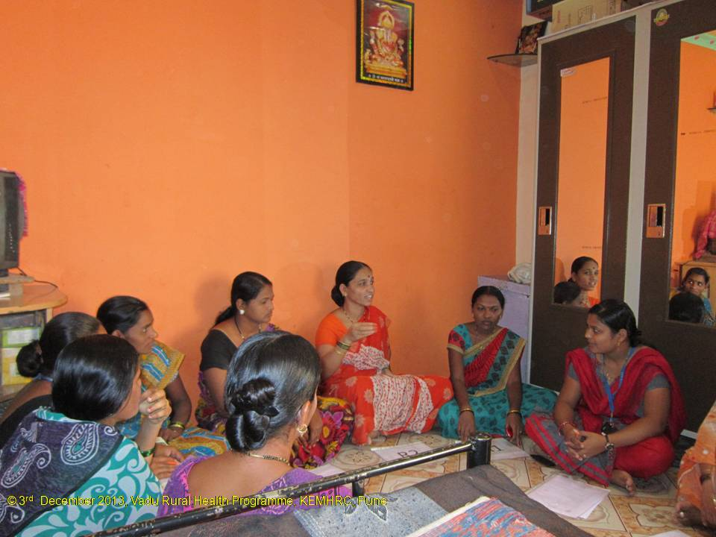
Findings 1: Psychosocial stress associated with toilet use
“Yes, it is a tension (worry). If you sit in the closed toilet then there is no fear but if you sit in an open place then there always remain tension that somebody may watch us”. KII with village chief, male
“In the summer season there are less problems than in the rainy season when going out in the open becomes difficult for women. We don’t feel like going there, it becomes very filthy”. A woman in a FGD
“They have the problem of finding an unfrequented place. Now there are no open spaces remaining as there were in the past which is a kind of hassle.” KII with health worker

Slide 11
Findings 1: Psychosocial stress associated with toilet use
Good Morning Committee: fear of punitive action, reported deaths
Lack of privacy is stressing in more situations than during act of defecation (e.g. carrying water, accessing latrines)
Seasonal migrant women report stress from lack of privacy but not fear for personal safety or injury
Often insufficient latrines in market places, at bus stands etc. This can lead to stress and unhealthy coping (e.g. drinking less)
Good toilets: clean, with water
Self-reported stress

Slide 12
Findings 2: Coping strategies in response to limited sanitation facilities
Reported coping mostly related to non-routine situations (e.g. travel)
More likely to report coping if higher level of stress is reported
Coping strategy (% of total) | Adolescents (n = 154) | Women (n = 154)
Delayed relief (19%) | 17% | 21%
Drinking less (8%) | 9% | 7%
Eating less (6%) | 5% | 6%
Combined (24%) | 22% | 27%
Medical problems due to coping (5%) | 7% | 3%

Slide 13
Findings 2: Coping strategies in response to limited sanitation facilities
“I have urine problem; if I drink water then I have to go for frequent urination in the night. So I drink less water.” Young woman in FGD
Some awareness for negative health effects of certain coping mechanisms (e.g. drinking less, delaying relief)
Coping with one stressor can result in another stress – e.g. delaying latrine use until after dusk increases fear of accidents and abuse

Slide 14
Findings 3: Menstrual hygiene practices and preferences
Cloth as absorbent material: 36% of adolescents and 62% of adults
Reasons for choice: ease of use, family practice, hygiene and comfort
>90% report no challenge to change - but 37% of adolescents report disposal problems in school latrines, and shame/embarrassment makes washing cloth difficult
Hand hygiene after changing is observed (reported)
Restrictions during menstrual period: 53% (adolescents )/67% (adults)
Limited access to prayer room (83%), kitchen (49%), domestic work (44%), religious/social activities (39%), bed (32%)
Migrants: limitations only observed when in native area
Not troubled by restrictions: 71%

Slide 15
Findings 3: Menstrual hygiene practices and preferences
Restrictions during menstruation: “It depends upon the family. If the family asks you to sit separately then you need to do so for four days.” Older woman in FGD
Troubling aspect of restriction during menstruation: “And the one who don’t know especially the men gets to know about it (menstrual period) after isolation. It gives the different feeling.” Adolescent girl in FGD
Difference between generations: “She (i.e. daughter) does not sit separately but I think that she should.” Older woman in FGD

Slide 16
Findings 4: Availability and perceived adequacy of WASH infrastructure in health facilities
 | Public (n=6) | Private (n=6) | Total (n=12)
Adequacy (latrines) good Improved Beds/latrines ratio Out-patients/latrines ratio | 4 3.5 34.0 | 6 4.1 6.7 | 10 3.9 14.0 | Flush toilets inside or outside One public facility without toilets One public facility without toilets
Adequacy (hand washing stations) good Pipe with tap Beds/HWS ratio Out-patients/HWS ratio | 4 5.6 55.3 | 6 3.9 6.3 | 10 4.2 15.0 | Distance <10 m from latrine Two public facilities without HWSs Two public facilities without HWSs
Functionality good Latrines Hand washing stations | 4 2 | 6 6 | 10 8 | Typically, no garbage bin is available Typically, no hand drying materials are available
Order and maintenance good Latrines Hand washing stations | 3 2 | 6 5 | 9 7 | Typically, no toilet paper is available Often, no soap is available
Accessibility good Latrines Hand washing stations | 4 3 | 6 6 | 10 9 | Indoor or convenient path Indoor or convenient path
Privacy ensured (latrines) | 5 | 5 | 10 | Typically, no gender separation.

Slide 17
Findings 4: Availability and perceived adequacy of WASH infrastructure in health facilities
Satisfaction
Questionnaire: Satisfactory WASH installations in health care facilities: 97%
FGD, KII: - WASH installations expected as part of basic infrastructure
Awareness of differences between public and private health care facilities: “Each private hospital has a toilet facility…they need because they have to run the business” KII with community leader
Improvements in government facilities over recent years
Impact on behaviour
Questionnaire: Consider WASH installations when deciding which health care institution to attend: 73%
FGD, KII: Good reputation and respected doctors and the ability to competently deal with complications are more important than the WASH situation: “We do not think about toilets if we soon [i.e.: the same day] come back. If we have to get admitted then it is given a thought” FGD with adolescent women

Slide 18
Conclusions and implications
Open defecation is less prevalent than in other parts of India
Girls and women experience stress where sanitation is insufficient (market places, bus stations etc), mainly related to lack of privacy and cleanliness, and fear of accidents Good toilets are clean and have water
(Fear of) violence related to open defecation seems not to be a prominent problem – but Good Morning Committees are feared.
Reduced fluid intake and withholding urine are common coping strategies
Restrictions during menstruation are common
Maintaining menstrual hygiene is challenging in schools and if cloth is used
WASH in health care facilities is commonly available – and expected; better installations in private than in public facilities
WASH installations are not a primary consideration when deciding which facility to use

Slide 19
Evidence gaps
Comparative studies in other communities in India (e.g. in urban, high prevalence of open defecation, more traditional and conservative states)
Real level of stress might be higher (assessed was self-reported stress!)
More subtle and less obvious evasive or adaptive strategies
Physiological health effects of the reported coping strategies
Impact of menstrual hygiene solution and school sanitation on school absenteeism
WASH installations in larger hospitals
Community perception of health facilities that lack basic WASH installations
Impact of WASH installation upgrades on the use of and satisfaction with health centers

Slide 20
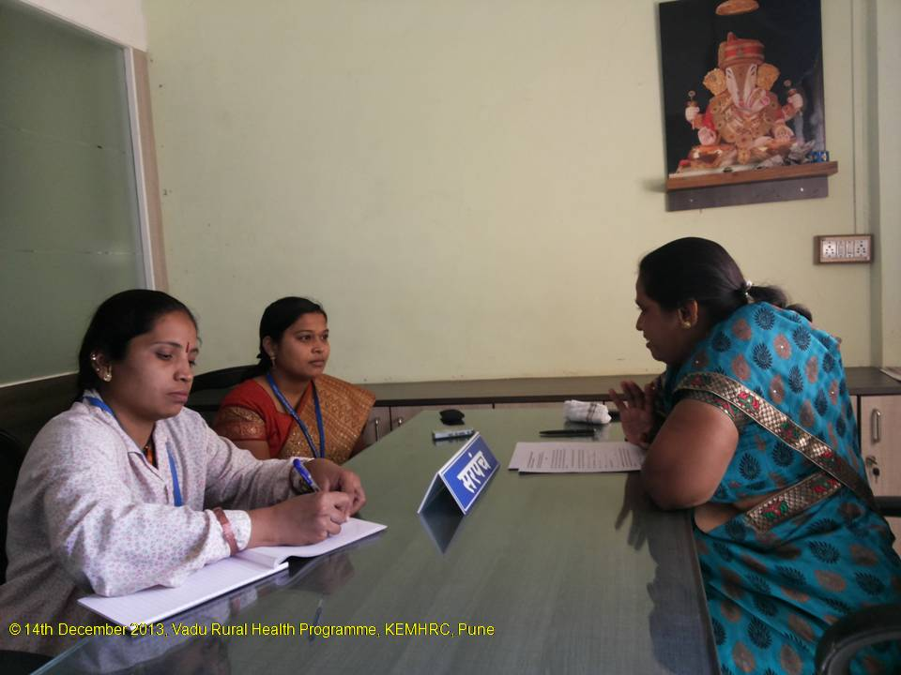
Thank you very much for your attention!

